Slide 1
Being in Community: Navigating Mental Health Conversations Together
The Charles River Regional Chamber’s Women’s Conference
Friday, June 12, 2026
Lasell University, Newton, MA

Slide 2
Before we begin
  Mental health and suicide are sensitive topics, and each of us brings our own personal experiences and feelings to the conversation
  Approach this space with empathy
  Take care of yourself as needed during and after
  Be curious
  Reach out if you need support
2

Slide 3

Today:
Explore how to build strong, supportive communities
Discuss how to navigate conversations around mental health
Recognize warning signs of suicide
Identify how to balance the many roles women hold
Notes:
This session explores building supportive communities, navigating mental health conversations, recognizing warning signs of suicide, and balancing the many roles women hold as professionals, caregivers, and more.

Slide 4
We envision a world without suicide.
Our mission is to prevent suicide and offer hope and support to those affected.​

Slide 5





Our Programs:
24/7 Helpline
Hey Sam - peer-to-peer textline for young people
Suicide Grief Support
Survivors of Suicide Attempts Support Group
Education, Training & Outreach

Slide 6
Who are we and how did we get here?

Slide 7
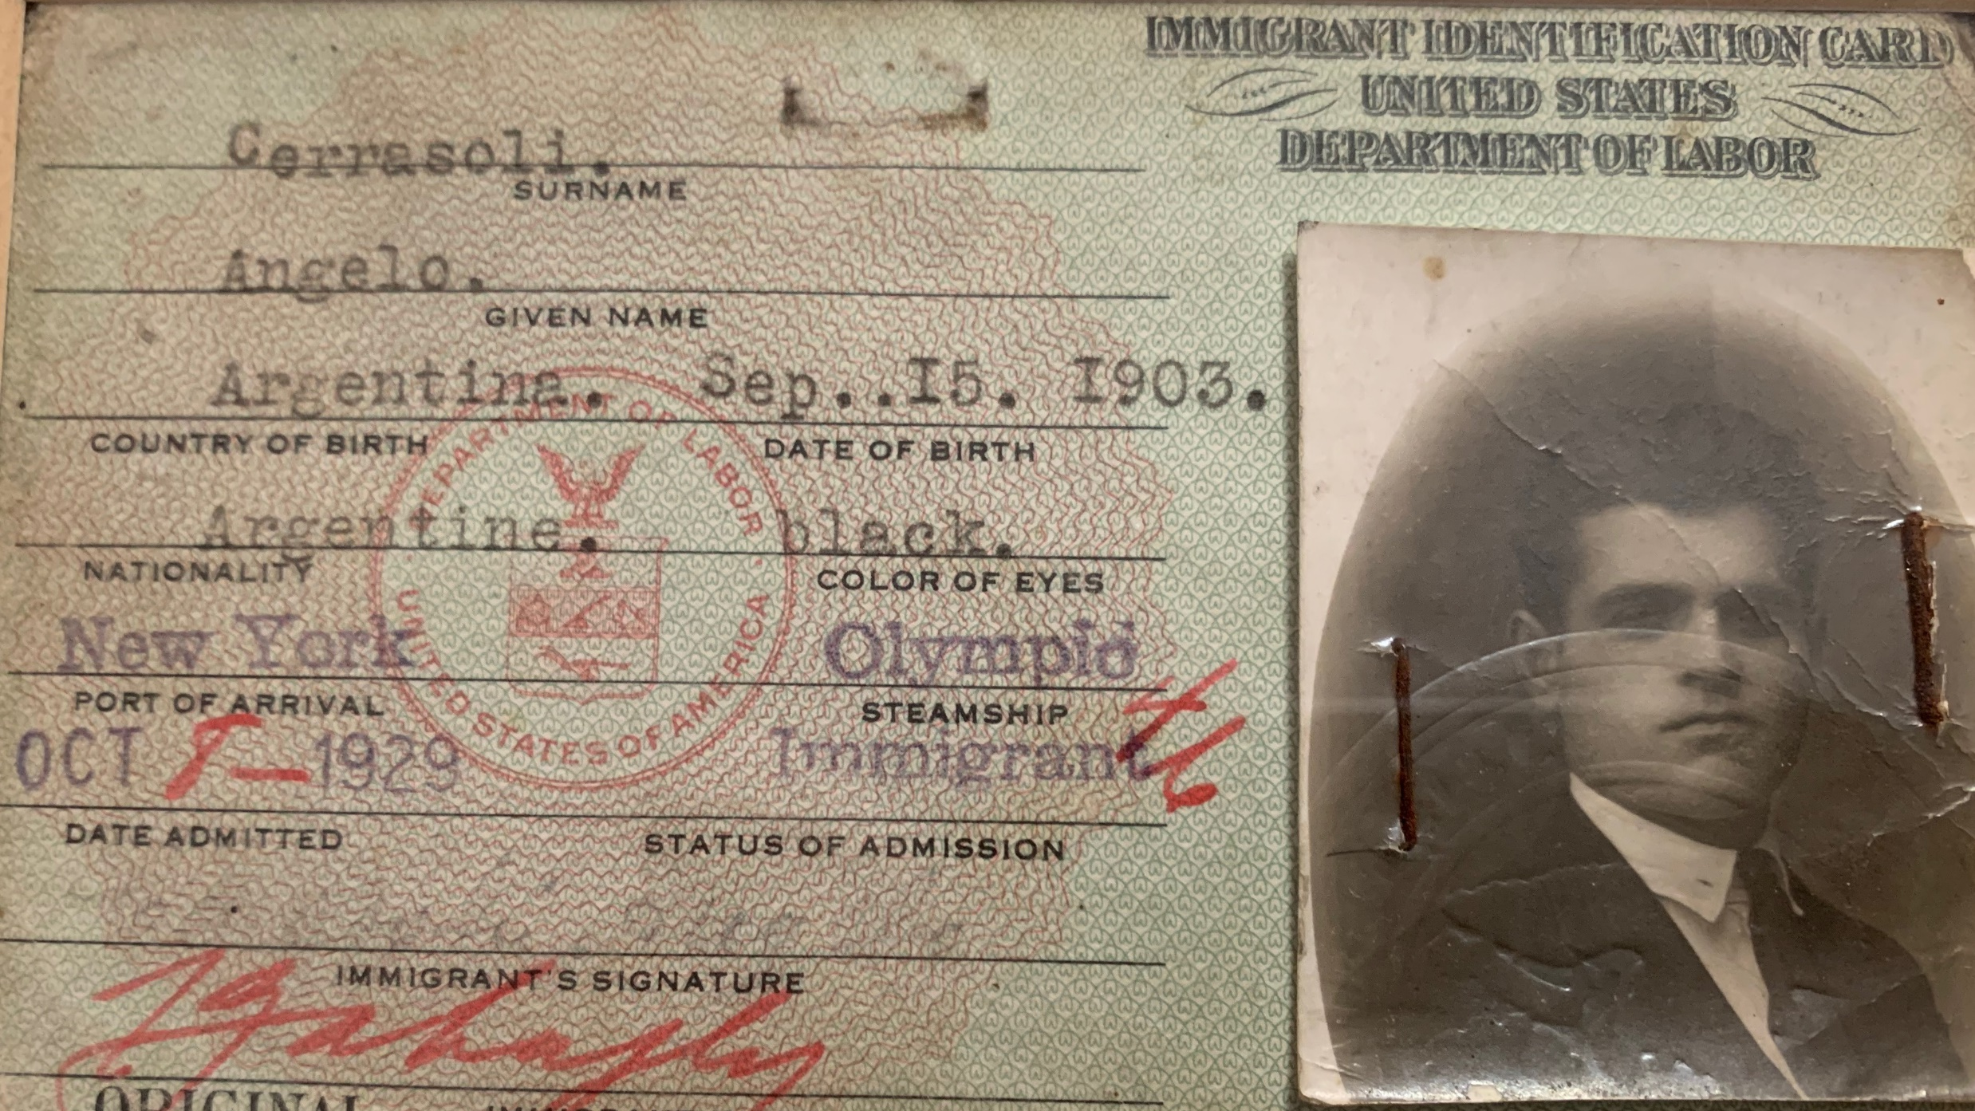
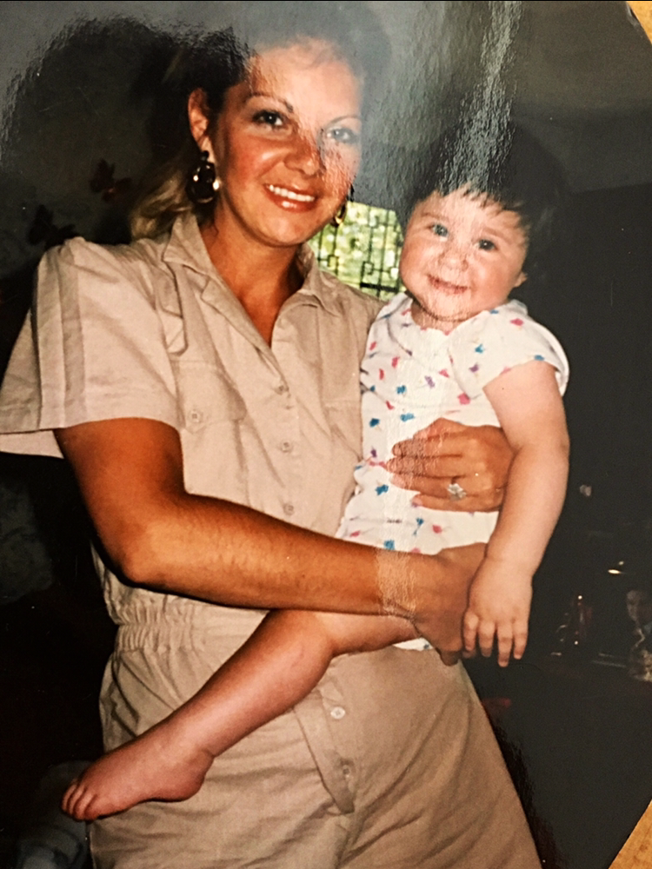
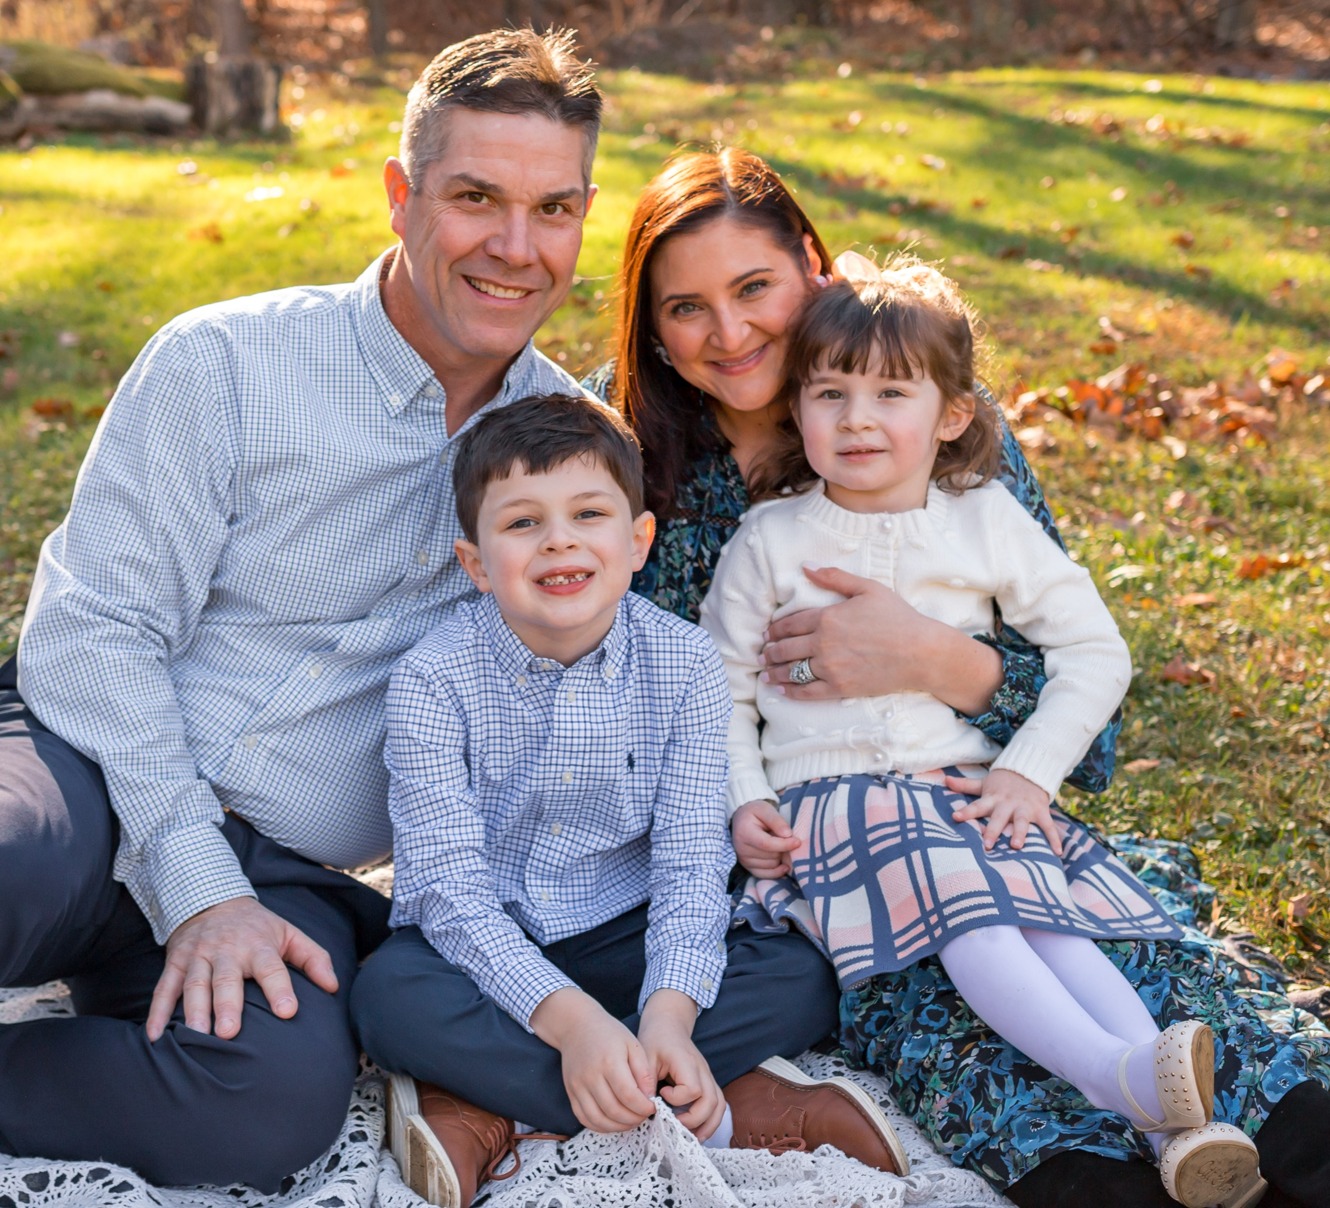
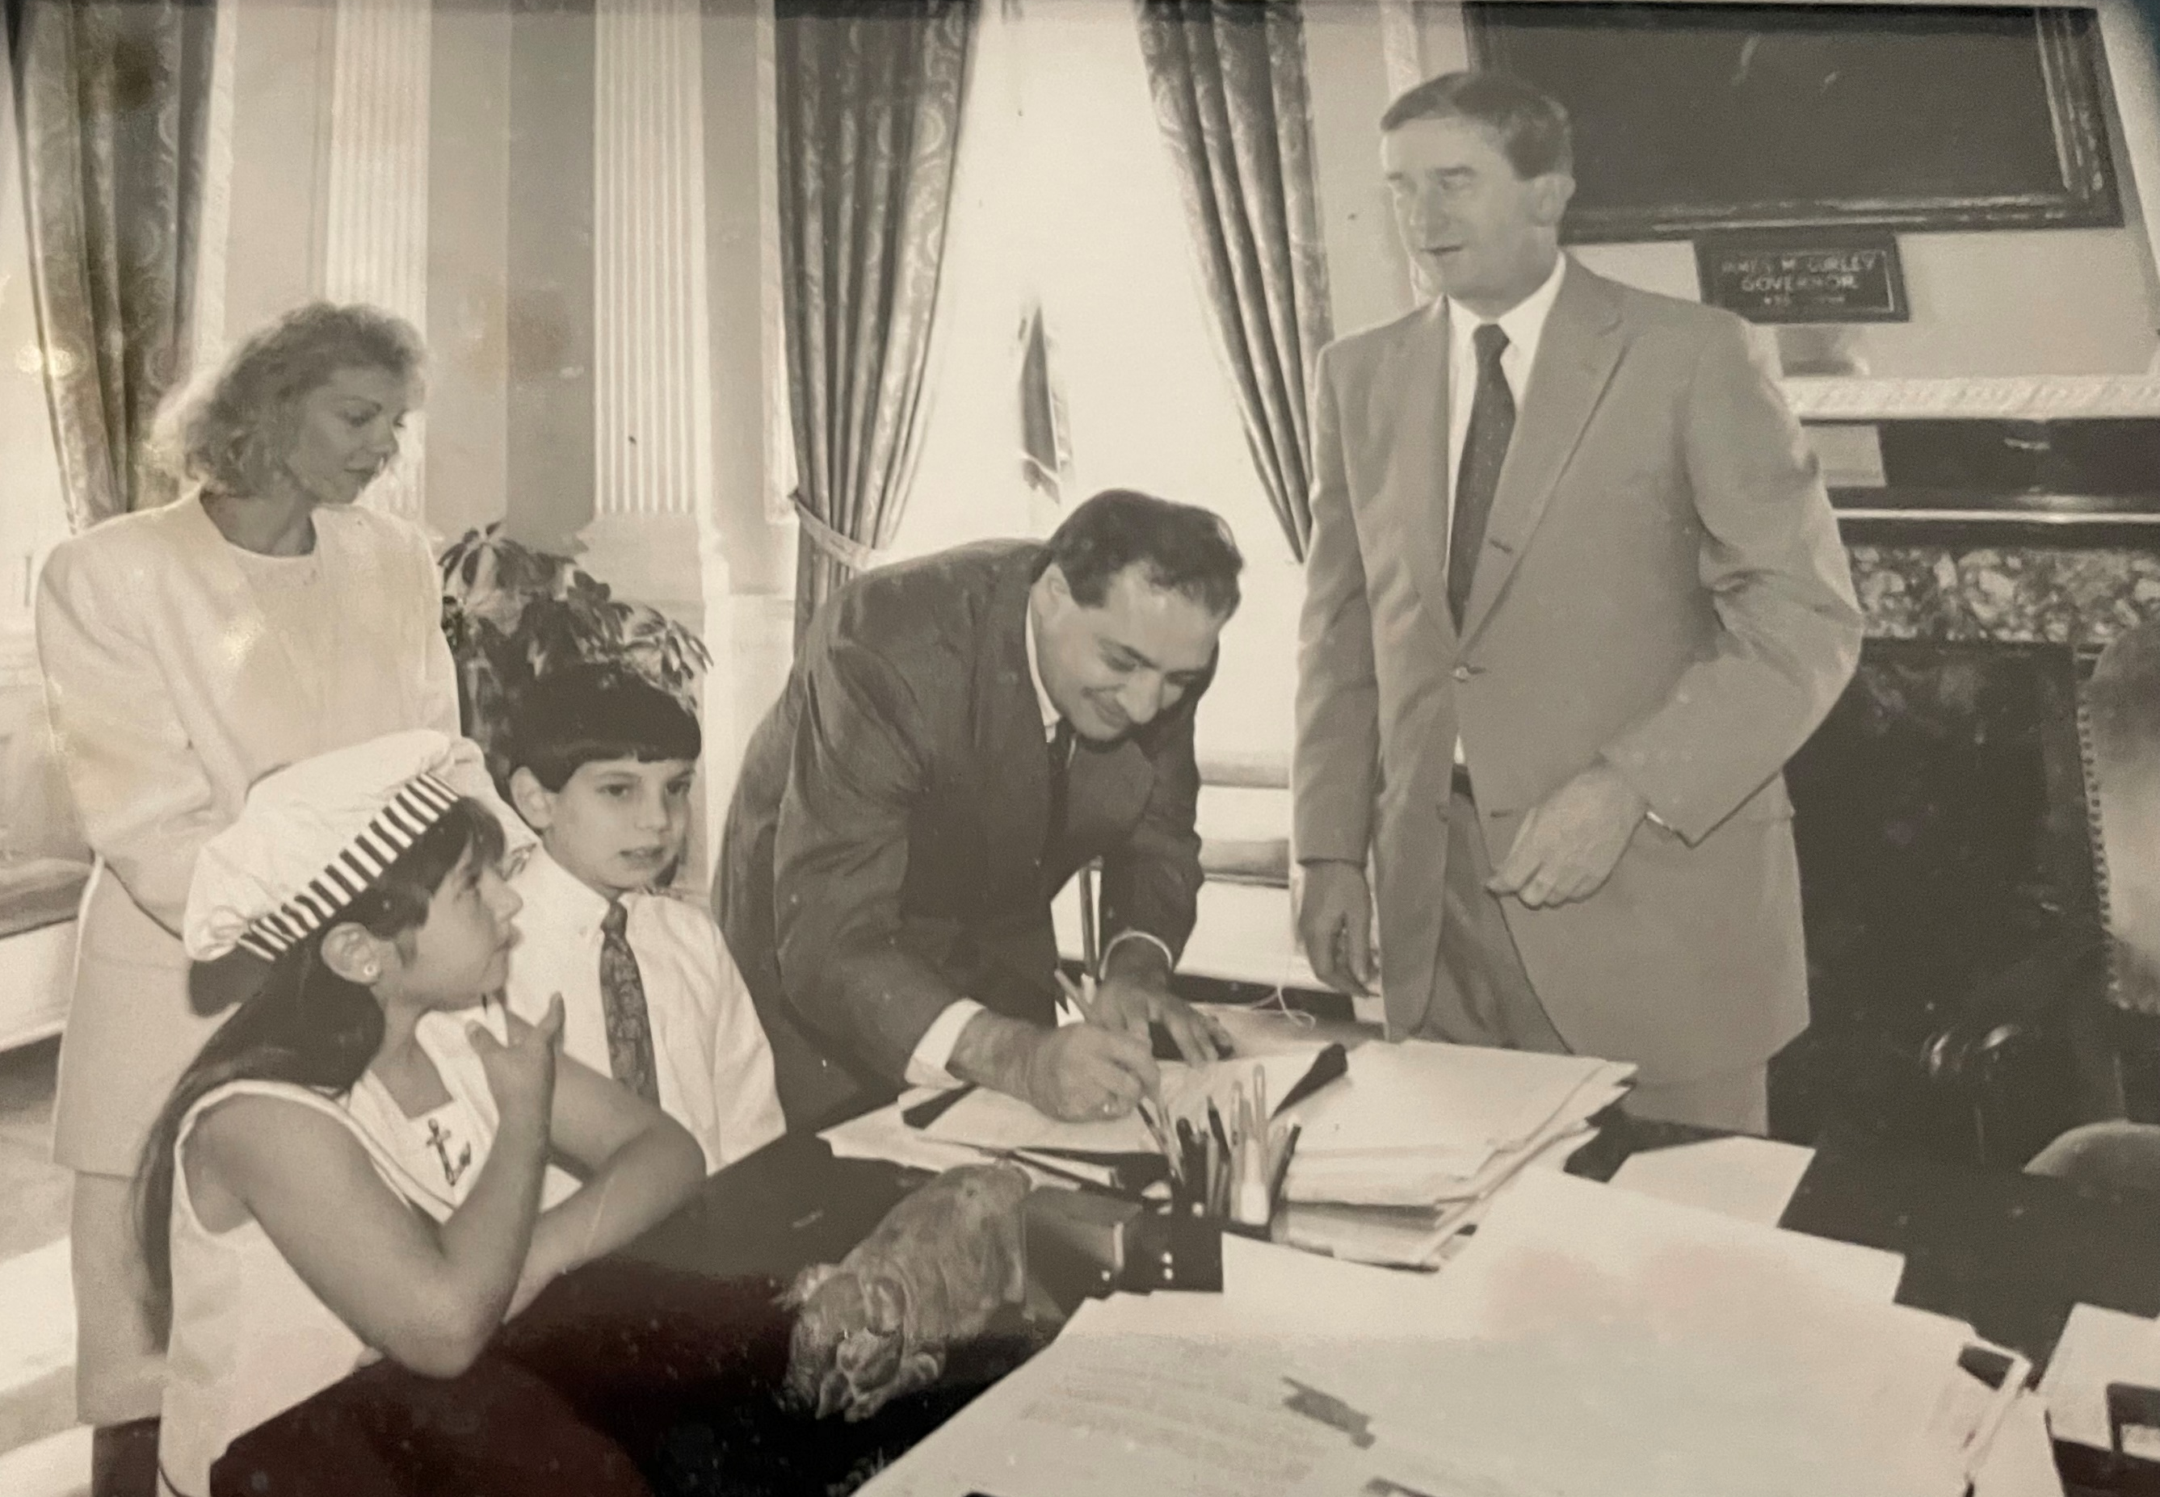

Slide 8
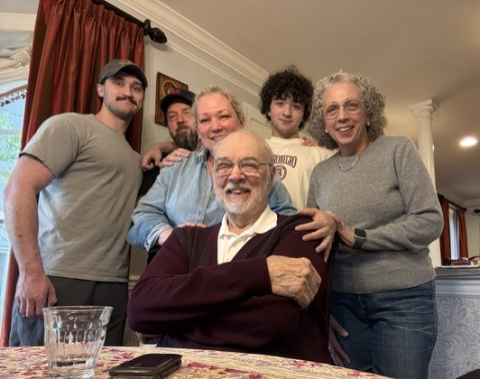




Slide 9
What are some of the ways you build and access community?
Notes:
Learned a lot about my last 15 months – here’s what I would have done differently
This is what I experienced there – here is what I would do now
All they hear is how great everyone is here.
Im really struggling – no idea how much that can do for somebody

Slide 10
Building Supportive Communities
Model the culture that you want – incorporate wellness into your workplace
Create structured ways to connect and debrief
Collaborate through your shared purpose and remind people why they are in the room
Adapt as needs change and evolve as needed
Be consistent and prioritize engagement

Slide 11
Complexity of Our Identities
We have to hold it all
and then some.
Women have to be:
  Strong but soft
  Caring but not emotional
  Feminine but not weak
  Decisive but not bossy
  Kind and firm, but not too firm

Slide 12
Walk the Walk
Model that two things can be true at the same time: you can be a strong leader and deal with challenges, personal or professional
Don't be afraid to say "I'm struggling" or "things have been hard lately" to show others that it is okay
Give yourself the grace you would grant others
Incorporate wellness in your day
Take a mental day to catch up at home, to show others that’s okay to do

Slide 13
Supportive communities require:
Nonjudgment
Active Listening
Collaboration
Connection
Curiosity
Peer Support
Belonging
Courage

Slide 14
Everyone struggles
61.5 Million people experience a mental health condition in the US
More than 1 in 5 women have a mental health condition
Females are about 50% more likely to experience mood disorders and depressive episodes
Notes:
https://womenshealth.gov/nwhw/mental-health
https://www.nimh.nih.gov/health/statistics/mental-illness

Slide 15



Suicide Facts & Figures
49,449
596
3.9x
people died by suicide in 2022 in the U.S.,
with more than 1.7 million attempts nationwide
suicides reported in Massachusetts, placing MA at 3rd lowest per capita in the U.S.
as many men die by suicide compared to women,
though women attempt more often
Sources: American Foundation for Suicide Prevention (2020), American Association of Suicidology (2017), Centers for Disease Control and Prevention (2017), World Health Organization (2016)

Slide 16
Risk Factors for Suicide
Family history of suicide
Previous suicide attempt
Physical/mental illness or depressive disorders
Physical, sexual, domestic, verbal and child abuse/trauma
Substantial loss (relational, social, financial, work)
Lack of access or connection to mental health care providers
Substance use or addiction
Housing insecurity
Lack of connection to supportive family, friends or social groups
Lack of purpose
Notes:
Suicide is complicated and not caused by any one factor

Slide 17
Warning Signs
“I’m tired of being a burden” or “no one would miss me if I were gone”
Changes in weight, appetite, hygiene, or appearance
Major changes in behavior
Sleeping too little or too much
Impulsive or risk-taking behavior
Withdrawing from friends, family or social connections
Giving away prized possessions and putting one’s affairs in order
Loss of pleasure or interest in activities

Slide 18
What do you say to someone who is struggling?
Notes:
Learned a lot about my last 15 months – here’s what I would have done differently
This is what I experienced there – here is what I would do now
All they hear is how great everyone is here.
Im really struggling – no idea how much that can do for somebody

Slide 19
Befriending is the art of truly listening
Non-judgment and empathy are core components to holding time and space for people
Stay away from problem solving or trying to make someone “feel better.”
Meet someone where they are and let them share their own emotions and experiences

Slide 20
Reflections
  Statements that convey to someone that you have heard what they are sharing with you by repeating or paraphrasing what you have heard
Validations
  Statements that universalize and normalize what someone is feeling by letting them know that their feelings make sense
Open-Ended Questions
  Questions that invite someone to reflect or elaborate on what they have already shared. These are questions that can't be answered with a "yes" or "no"

Slide 21
Honest conversations happen when rapport is built
  People want a runway to share how they’re feeling
  Speak to others as an equal
  Put your phone away and make eye contact
  Be authentic and genuine
  Talk in a private space if possible
21
30

Slide 22
What do you actually say?
What’s today been like for you?
That must have been really hard to experience.
When you say you feel frustrated, can you say more about what that means to you?
Anyone in your position would feel overwhelmed with all that’s going on.

Slide 23
Ways you can lean in:
For yourself:
Engage in self-reflection – what do I need right now?
Be open to having honest conversations
Ask for help when you need it
For others:
Go beyond asking, “What’s up?”
Encourage conversation
“What has been going on lately?”
Pursue connection
  “Let’s get lunch”
  “Want to go for a walk?”

Slide 24

Ask the hard question
Asking about suicide directly is important and does not put the idea in someone’s mind.
  Are you feeling suicidal?
  Sometimes, when people feel overwhelmed like this, they think about suicide. I’m wondering if you’re feeling that way too?
Notes:
Destigmatizing – Asking about suicidal directly

Slide 25
Get Help
If there is a plan, the means are available, and the time is set and immediate, the person is considered at imminent risk of suicide, and you should reach out for help right away.
  Collaborate with colleagues, friends, family, clergy
  Call 988
  Never worry alone

Slide 26
Offering Resources
“Thank you so much for sharing this with me. It can be hard to talk about this and our own mental health, but there are resources for support that exist. 988 is a free & confidential support line that you can call or text 24/7.”

Slide 27
Where can you access support?
Call or Text 988 & for those under 24 text Hey Sam at 439-726 – these are free and accessible to all
Employee Assistance Programs
Behavioral Health Helpline (BHHL): Call or Text 833-773-2445
William James College Interface Referral Service
Samaritans Suicide Grief Support Services
Samaritans is here as a resource for you

Slide 28
Questions?

Slide 29
Final Thoughts
We all have a role to play in supporting others and building community, even if it feels small
Active, nonjudgmental listening is effective and necessary
For many, thoughts of suicide are temporary and with time and support, things can get better
Take care of yourself today and always

Slide 30
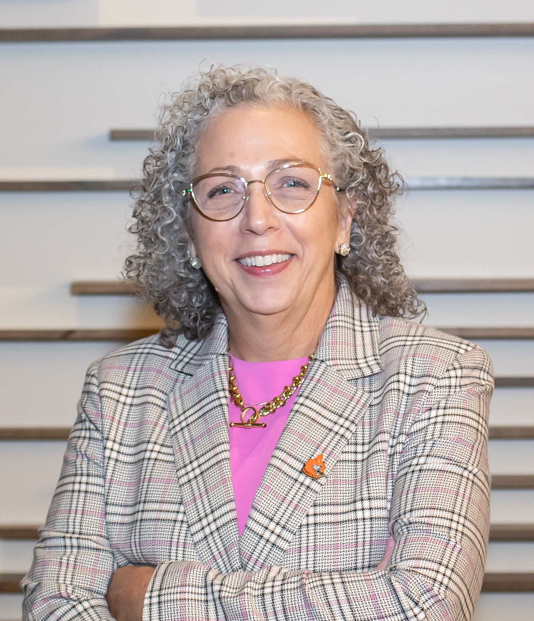

Kathleen C. Marchi
Chief Executive Officer & President
Samaritans, Inc.
Kmarchi@samaritanshope.org
Kacy C. Maitland, LICSW
Chief Clinical Officer
Samaritans, Inc.
Kmaitland@samaritanshope.org

