Slide 1

KEYNOTE SPEAKING SERIES
The Human ROI
How Personal Branding Fuels Business Growth
How do you think your personal strengths and experiences drive business?
CHAMP Digital

Slide 2

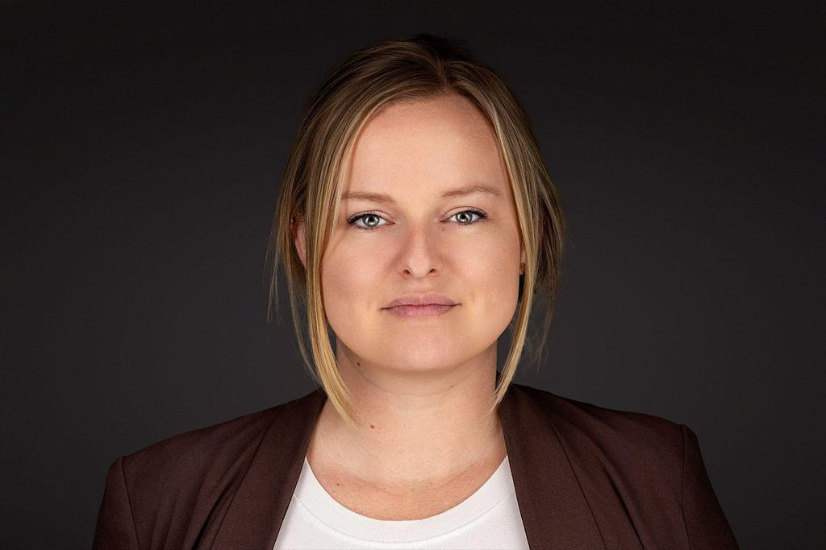




About the Speaker
Emily Tuttle
Director of Business Development, CHAMP Digital
Over a decade of experience in new business development, both in regulated and non regulated industries. Leveraging personal experience in order to foster connection to help grow personal and professional networks.
SPECIALTIES
CORE MISSION
New Market Growth Networking & Strategy
Helping grow businesses with unique marketing and sales strategies.
CHAMP Digital
02 / 14

Slide 3




A Human Connection
AUDIENCE QUICK-CHECK
"People do not do business with logos. They do business with people."
What is one word that comes to mind when you hear:
In a highly digital, automated and AI driven world, human trust remains the single most valuable transactional metric.
Is it authenticity, vanity, necessity, or strategy?
CHAMP Digital
03 / 14

Slide 4








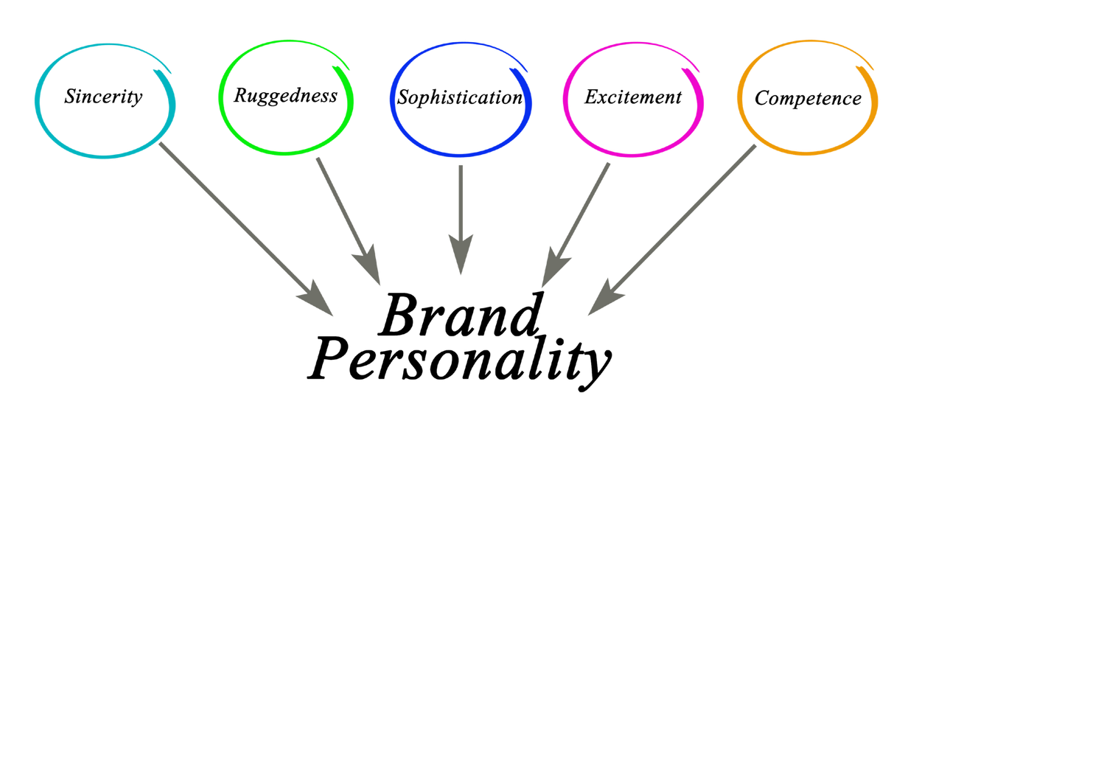
Today's Points
Personal Brand vs. Business Brand
Mindset = Confidence
Consistent Action
Understand the powerful relationship between individual thought leadership and organizational success.
Identify mindset patterns that you might not realize are holding you back from sharing your expertise.
Learn doable and actionable strategies to build a strong personal brand (or empower your employees to do so).
CHAMP Digital
04 / 14

Slide 5


Trust Me, I’m Chat GPT?
The Current Trust Deficit
People are your greatest power – as a professional and as a business. Learning how to leverage your personal brand to fill in gaps of trust created by AI and paid content protects you for the long-run.
An organization’s greatest assets are no longer advertising budget, traditional KPIs, and old school methods—it is the combined influence of its people and the individual strengths they bring to the business.
CHAMP Digital
05 / 14

Slide 6




What is a Personal Brand, Really?
Demystifying the Concept
A personal brand is not about being a flashy, polished social media "influencer."
It is simply your professional reputation.It’s your professional reputation, your values, and how you solve problems for others. This includes clients and people on your team!
THE REPUTATION EQUATION
CHAMP Digital
06 / 14

Slide 7









The Brand Worksheet
PROMPT 1
PROMPT 2
PROMPT 3
Unique Expertise
Target Audience
Core Values
What is my unique area of expertise? (What do colleagues always ask me for help with?)
Who is your target audience. Who needs your strategic experience most to solve their business problems? (Clients, peers, leadership?)
What is one core value I want associated with my professional name?
CHAMP Digital
07 / 14

Slide 8







The Human ROI
For the Organization
For the Individual
Career Asset: Expands your network, your knowledge and skill sets, make you a resource.
More Reach: Employee networks help to grow corporate networks.
More Trust: People are more likely to buy when they connect on some level with who they are partnering with.
Networking Is a Skill: Attracts opportunities organically if you work at it.
More Power: Leaders build workspaces where talent is recognized as an asset.
Personal Authority: Networking uncovers hidden talents, knowledge and experience.
CHAMP Digital
08 / 14

Slide 9

Empowering the Team
Content: How do I to create a culture that encourages employees to share their ideas and skill sets?
An Open Content Forum: Create a centralized hub (like a dedicated Slack channel, and fill it with open prompts. Let employees choose what resonates with them and encourage them to engage by sharing your own thoughts. This opens conversations, allows for you to see where hidden strengths could lie within the team.
Thought Leadership: The above idea helps to identify employees who are passionate about their niche and in turn give them the opportunities to say write articles, speak at webinars, or guest on podcasts. Encourage your team to be ambassadors
The 80/20 Rule: Encourage employees to use their platforms to share 80% industry insights, personal learnings, or peer shout-outs, and only 20% direct company promotion.
Executive Vulnerability: When founders or C-suite executives share their own wins, challenges, or lessons learned on social media, it sets a precedent. It signals to the rest of the company that it is safe—and encouraged—to be human online.
Celebrate Culture: LOUDLY. Create a space where teams not only can but WANT to brag about each other. Make a big deal out of work “wins”, promotions, and personal milestones.
Key Points: Provide guidelines, celebrate employee wins publicly, and lead by example.
CHAMP Digital
09 / 14

Slide 10




Platform Strategies to Amplify
Personal Execution
Unlocking talents allows you to be an educational resource in your field. You have to practice this! Consistent strategy and intention work far better than random execution.
Share Your Journey: Share your personal stories, pivots, and lessons. Stories hold a lot of weight in building trust.
Engage Actively: Contribute real perspectives to industry leaders and networks. Stop posting randomly and into empty voids. Comments that add value will increase trust..
NOTE
Progress always works better than perfection.
Pace Over Polish: Establish a weekly routine to check in on your networks.
CHAMP Digital
10 / 14

Slide 11







First Micro-Steps
Optimize Your Bio
Add One Learning
Connect & Write
Update digital bio headers. State your clear target outcome, not just a plain company title.
Draft a single post sharing a critical moment for you professionally/personally recently. A learning you took across multiple areas. .
Identify 5 targeted industry leaders. Leave insightful feedback on their posts today. Or connect with them and write a personalized note.
CHAMP Digital
11 / 14

Slide 12

Mindset on Public Platforms
“I am bragging if I post accomplishments on LinkedIn”
Reframe: “Insight sharing is a client service. My experiences are valuable insights that can genuinely help someone”
“My personal stories shouldn’t be brought into business conversations”
Reframe: “Clients relate to personalities first. I build trust much faster when people relate to me”
“I don’t have anything unique to say”
Reframe: “My specific experience and perspective is my superpower”
“My boss will think I am looking for a new job”
Reframe: “I am acting as a proud and proactive person for myself and for the company. My individual opinion is relevant”
CHAMP Digital
12 / 14

Slide 13

"Be yourself, everyone else is already taken"
— Oscar Wilde
CHAMP Digital
13 / 14

Slide 14


Connect & Grow
Let's discuss translating professional presence into lasting business growth.
emily.tuttle@champdigital.com
617-420-3116
CHAMP Digital
14 / 14

