Slide 1

Stop Competing with Your Old Self:
Break the patterns limiting your impact
Mel Cidado
Leadership Coach & Consultant
Breakthrough Coaching

Slide 2


Slide 3
Most of us aren’t competing with other people.
We’re competing with a version of ourselves that no longer fits.

Slide 4

Invisible pressure

Slide 5



Why it’s so hard

Slide 6


Slide 7




Understanding the Four Leadership Patterns
The Doer
The Pleaser
The Prover
The Protector
Notice which pattern shows up most for you as we go through each one.

Slide 8
The Doer
“I want to be dependable and deliver results people can count on.”
Beliefs: It’s faster if I do it myself. If I don’t do it, it won’t get done right.

Slide 9
The Pleaser
“I want people to know I’m supportive and they can lean on me.”
Belief: It’s my job to make things easy for others.

Slide 10
The Prover
“I want to bring real value and earn credibility through my expertise.”
Belief: It’s my job to have all the answers, or I lose credibility.

Slide 11
The Protector
“I want to uphold the standard of excellence the customer expects.”
Belief: If I step back, everything will fall apart.

Slide 12
Turn to someone near you & discuss:
Which pattern shows up most for you?
What is it quietly costing you?
2 minutes. Go!

Slide 13





The shift
Surface
Own it
(re)Anchor
Rise
What outdated rule am I operating from?
How did it serve me?
Why is it still here today?
Does it still belong?
Who am I
becoming?

Slide 14
Take 90 seconds and write down
What is the rule underneath your pattern? This is your “I should...” statement.
How has it served you?
Name it. Honor it.

Slide 15
We don’t break patterns by force.
We outgrow them.

Slide 16
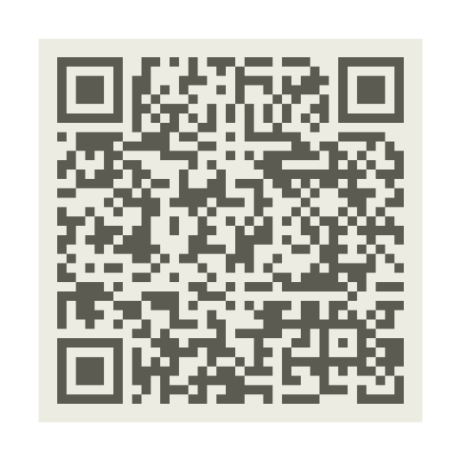
You've started the work.
Find out exactly where your pattern is showing up.
Thank you!
mel@getbreakthroughcoaching.com
https://www.getbreakthroughcoaching.com

